Slide 1
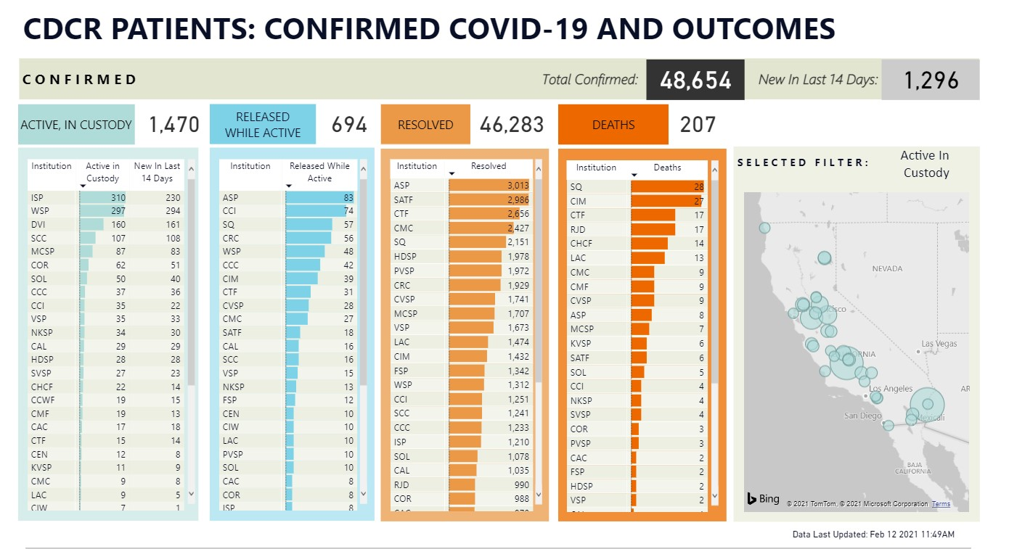
SARS-COV-2 Neutralizing Monoclonal Antibody Therapy in a Congregate Setting
Kabir Matharu, MD(1,2), Sarah K Westcott, BA (2)
1. California Department of Corrections and Rehabilitation
2. University of California Davis Medical Center, Department of Internal Medicine, Division of Cardiovascular Medicine
BACKGROUND
METHODS
RESULTS
Severe acute respiratory syndrome coronavirus 2 (SARS-COV-2) causes coronavirus disease 2019 (COVID-19), which can range from mild symptoms to death from respiratory failure and multi-organ dysfunction.
Correctional facilities serve as a nidus for infection due to limited space from overcrowding which is further complicated by an increasingly elderly and sick inmate population.
California, which houses nearly 95,000 inmates, has the largest inmate population of any state in the US.
LY-CoV555, also known as bamlanivimab, has been shown to reduce viral load in patients as soon as within one week of administration.
This study reports data on inmate-patients who were offered LY-CoV555 therapy based on the EUA and clinical judgement of providers rounding on COVID patients at one correctional facility.
No data exists on the utilization of LY-CoV555 and outcomes associated with its use in a congregate setting.
In this observational study, inmates within a state correctional facility were offered LY-CoV555 consistent with the FDA’s Emergency Use Authorization (EUA).
In accordance with state and federal policy, the inmates were not given any incentive or punishment if they accepted or declined treatment.
The primary outcome measure included the number of adverse outcomes from infusion and how many patients required a transfer to higher level of care secondary to COVID-related complications.
At the time of analysis, no patients had an adverse reaction to the infusion and 2 patients out of 95 (2.1%) who received LY-CoV555 required transfer to an emergency room for management of COVID complications.
The study included 38% of patients who were older than 65 years of age, 46% who were white, and 87% who were at high risk for developing severe COVID infection.
Table 1: Baseline characteristics and outcomes
Characteristic
Age
Median (range)- yr | 60 (29-91)
65 yr or older — no. (%) | 36 (37.9)
Male — no. (%) | 95 (100)
Race/Ethnicity –no./total no. (%) *
White, n (%) | 44 (46.3)
Black, n (%) | 13 (13.7)
Hispanic, n (%) | 33 (34.7)
Other, n (%) | 5 (5.3)
Body Mass Index†
Median (range) | 29.1 (20.2-47.9)
≥30 to <40 — no./total no. (%) | 11/95 (11.6)
≥40 — no./total no. (%) | 9/95 (9.5)
Risk factors for severe COVID-19 –no. (%)‡ | 81 (85.3)
Emergency Room Visit or Inpatient admission –no. (%) | 2 (2.1)
* Race or ethnic group was reported by the patients and confirmed through review of the electronic health record.
† The body-mass index is the weight in kilograms divided by the square of the height in meters.
‡ Risk factors included an age of 65 years or older, a body-mass index of 35 or greater, or at least one coexisting illness.
DISCUSSION
In this observational study of a large cohort of medically complex and racially diverse patients within a congregate setting, LY-CoV555 administration was safe and the number of patients requiring higher level of care evaluation was lower than anticipated suggesting a possible therapeutic effect of neutralizing antibody.
More studies are needed on the large-scale implementation of LY-CoV555 administration in diverse patient populations, however this study proposes one method of accomplishing this task in medically complex cohort.
Figure 1. CDCR data regarding COVID-19 infections in prison populations in California . https://www.cdcr.ca.gov/covid19/population-status-tracking/
ACKNOWLEDGEMENT
We would like to thank UC Davis for sponsoring the medical student’s time for completing this project.

